Slide 1
Basic serialization
Module 10

Slide 2
Agenda
Introduction to Serialization
Manage Serialization

Slide 3
Introduction to Serialization

Slide 4
What is serialization?
Serialization is the process of translating data structures or object state into a format that can be stored (for example, in a file or memory buffer, or transmitted across a network connection link) and reconstructed later in the same or another computer environment
Wikipedia

Slide 5
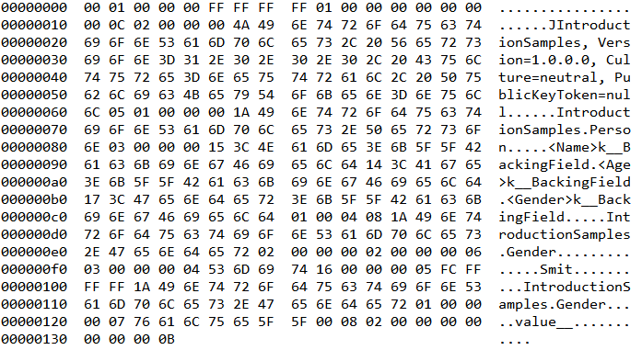
Serializations types
Binary
ProtoBuf
MessagePack
Custom
Text (human readable):
XML
JSON
YAML
{ "Name": "Smit", "Age": 22, "Gender": 0 }
<?xml version="1.0"?> <Person xmlns:xsi="http://www.w3.org/2001/XMLSchema-instance"
xmlns:xsd="http://www.w3.org/2001/XMLSchema"> <Name>Smit</Name> <Age>22</Age> <Gender>Male</Gender> </Person>

Slide 6
.Net Serializers
Standard
Third-party
Binary
System.Runtime.Serialization.Formatters.Binary.BinaryFormatter
XML
System.Runtime.Serialization.Formatters.Soap.SoapFormatter (obsolete)
System.Xml.Serialization.XmlSerializer
System.Runtime.Serialization.DataContractSerializer
System.Runtime.Serialization.NetDataContractSerializer
JSON
System.Web.Script.Serialization.JavaScriptSerializer
System.Runtime.Serialization.Json.DataContractJsonSerializer
Binary
MessagePack
MsgPack
Protocol Buffers
Google Protobuf
Protobuf-net
JSON
Json.NET

Slide 7
Simple samples
BinaryFormatter
var serializer = new BinaryFormatter(); var stream = new FileStream(FileName, FileMode.Create); serializer.Serialize(stream, Person.Instance); stream.Close();
var serializer = new BinaryFormatter(); var person = serializer.Deserialize(
new FileStream(FileName, FileMode.Open)) as Person;
XmlSerializer
var serializer = new XmlSerializer(typeof(Person)); var stream = new FileStream(FileName, FileMode.Create); serializer.Serialize(stream, Person.Instance); stream.Close();
var serializer = new XmlSerializer(typeof(Person)); var person = serializer.Deserialize(
new FileStream(FileName, FileMode.Open)) as Person;
JavaScriptSerializer
var serializer = new JavaScriptSerializer(); var str = serializer.Serialize(Person.Instance);
var serializer = new JavaScriptSerializer(); var str = File.ReadAllText(FileName); var person = serializer.Deserialize<Person>(str);

Slide 8
Compare serializers
 | BinaryFormatter | XmlSerializer | DataContract Serializer | NetDataContract Serializer | JavaScript Serializer | DataContract JsonSerializer
Format | Custom binary | XML | XML | XML | JSON | JSON
What serialize? (fields / public members) | All fields | Public members | Public members | Public members | Public members | Public members
Portable? | No | Partial | Yes | No | Yes | Yes
Human-readable? | No | Yes | Yes | Yes | Yes | Yes
Version-tolerant? | Partial | Yes | Yes | Yes | Yes | Yes
Save metadata to output stream? | Yes | No | No | Yes | No | No

Slide 9
Manage Serialization

Slide 10
Serializable / Not serializable
 | BinaryFormatter | XmlSerializer | XXXContract Serializer | JavaScript Serializer
Mark serializable class | [Serializable] | - | - | -
Default serialize members | Fields (public and private) | Public fields / properties | Public fields / properties | Public fields / properties
Mark non serialized members | [NonSerialized] | [XmlIgnore] | [NonSerialized] | [ScriptIgnore]
public class A { public string PropertyA { get; set; } [XmlIgnore] public string PropertyB { get; set; } }
<?xml version="1.0" encoding="utf-16"?> <A xmlns:xsi="http://www.w3.org/2001/XMLSchema-instance" xmlns:xsd="http://www.w3.org/2001/XMLSchema"> <PropertyA>A</PropertyA> </A>

Slide 11
Inner classes in Binary Serialization
public class Inner { public int i; } [Serializable] public class A { public int j; public Inner inner; }
System.Runtime.Serialization.SerializationException: Type 'ManageSerializationSamples.Inner' in Assembly 'ManageSerializationSamples, Version=1.0.0.0, Culture=neutral, PublicKeyToken=null' is not marked as serializable.

Slide 12
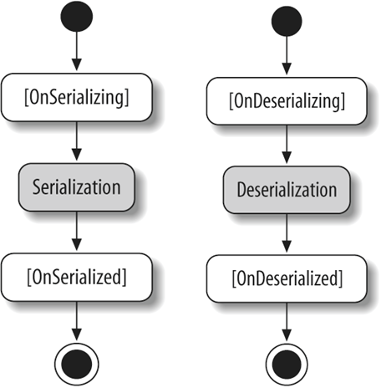
Deserialization
 | BinaryFormatter | XmlSerializer | XXXContract Serializer | JavaScript Serializer
Default constructor | - | + | - | -
Serialization callbacks | + | - | + | -
class MyClass
{
[OnSerializing]
void OnSerializing(StreamingContext context) { }
[OnSerialized]
void OnSerialized(StreamingContext context) { }
[OnDeserializing]
void OnDeserializing(StreamingContext context) { }
[OnDeserialized]
void OnDeserialized(StreamingContext context) { }
}

Slide 13
Customize output for composite objects
 | BinaryFormatter | XmlSerializer | XXXContract Serializer | JavaScript Serializer
Serializable type formatting | - | [XmlType], [XmlRoot] | [DataContract]
Serializable member formatting | - | [XmlElement], [XmlAttribute] | [DataMember]
[XmlType(TypeName = "ClassA")] public class A { [XmlAttribute] public string PropertyA { get; set; } [XmlAttribute("B")] public string PropertyB { get; set; } [XmlElement("C")] public string PropertyC { get; set; } }
<?xml version="1.0"?> <ClassA xmlns:xsi="http://www.w3.org/2001/XMLSchema-instance" xmlns:xsd="http://www.w3.org/2001/XMLSchema" PropertyA="A" B="B"> <C>C</C> </ClassA>

Slide 14
Object Hierarchy
 | BinaryFormatter | XmlSerializer | XXXContract Serializer | JavaScript Serializer
Declare child types | - | [XmlInclude] | [KnownType] | Not Supported (only serialization)
[KnownType(typeof(B)), KnownType(typeof(C))] [XmlInclude(typeof(B)), XmlInclude(typeof(C))] public class A { public string PropertyA { get; set; } } public class B : A { public string PropertyB { get; set; } } public class C : A { public string PropertyC { get; set; } }
<?xml version="1.0"?> <ArrayOfA xmlns:xsi="http://www.w3.org/2001/XMLSchema-instance"
xmlns:xsd="http://www.w3.org/2001/XMLSchema"> <A> <PropertyA>A</PropertyA> </A> <A xsi:type="B"> <PropertyA>A</PropertyA> <PropertyB>B</PropertyB> </A> <A xsi:type="C"> <PropertyA>A</PropertyA> <PropertyC>C</PropertyC> </A> </ArrayOfA>

Slide 15
Collections / Arrays
 | BinaryFormatter | XmlSerializer | XXXContract Serializer | JavaScript Serializer
Supported collection types | All | Array, IEnumerable, ICollection | Array, IEnumerable, ICollection, IDictyonary | Array, IEnumerable, IDictyonary
Mark collection / array | - | [XmlArray] | [CollectionDataContract] | -
Mark collection / array items | - | [XmlArrayItem] | [CollectionDataContract] | -
[CollectionDataContract(Name = "Cities", ItemName = "City")] public class Cities : List<string> { }; public class B { public Cities C { get; set; } }
public class A { [XmlArray("Cities"), XmlArrayItem("City")] public List<string> C { get; set; } }
<CollectionSample.B> <C> <City>Moscow</City> <City>Izhevsk</City> <City>Minsk</City> </C> </CollectionSample.B>
<?xml version="1.0"?> <A> <Cities> <City>Moscow</City> <City>Izhevsk</City> <City>Minsk</City> </Cities> </A>

Slide 16
Enumerations
 | BinaryFormatter | XmlSerializer | XXXContract Serializer | JavaScript Serializer
Default serialization as … | Value | Name | Name | Value
Mark enumeration member | - | [XmlEnum] | [EnumMember]
enum ContactType
{
[EnumMember(Value = "MyCustomer")]
Customer,
[EnumMember]
Vendor,
[EnumMember]
Partner
}

Slide 17
Object graph serialization
 | BinaryFormatter | XmlSerializer | XXXContract Serializer | JavaScript Serializer
Serialization type | Graph | Tree | Tree or Graph | Tree
Change type | - | - | PreserveObjectReferences = true
[Serializable] public class A { public int P1 { get; set; } } [Serializable] public class B { public A A1 { get; set; } public A A2 { get; set; } }
new DataContractSerializer(
typeof(B), new DataContractSerializerSettings {
PreserveObjectReferences = true
})
<GraphSerialization.B > <A1> <P1>1</P1> </A1> <A2> <P1>1</P1> </A2> </GraphSerialization.B>
<GraphSerialization.B z:Id="1"> <A1 z:Id="2"> <P1>1</P1> </A1> <A2 z:Ref="2" i:nil="true"/> </GraphSerialization.B>

Slide 18
Versioning
 | BinaryFormatter | XmlSerializer | XXXContract Serializer | JavaScript Serializer
Versioning by default | - | + | + | +
Optional members | [OptionalField] | By default | By default | By default
Required members | By default | - | [DataMember(IsRequired=true)] | -
Default order | Declaration order | Declaration order | By Name | Declaration order
Set order | - | [XmlElement(Order =1) | [DataMember(Order=1)] | -
[Serializable] public class Address { public string Street; public string City; [OptionalField(VersionAdded = 2)] public string Country; }
Data Contract Versioning
Version Tolerant Serialization

